Slide 1
October 2, 2019
Atlantic Shores Offshore Wind
NJCRWP

Slide 2

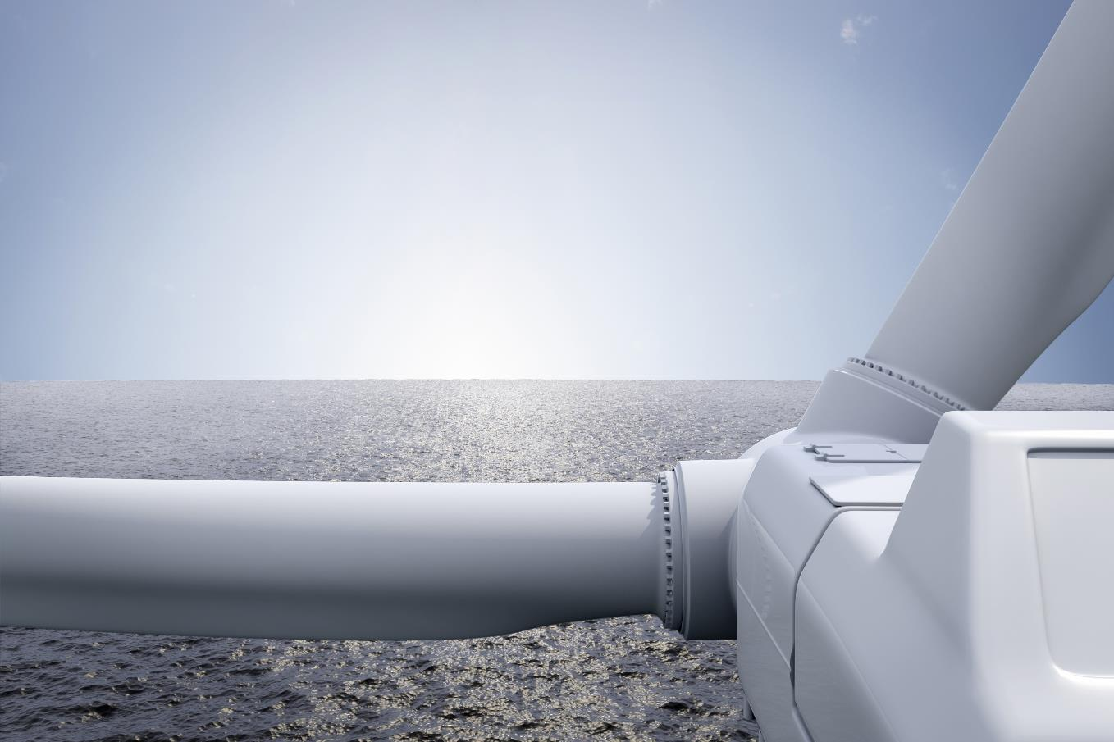

EDF Renewables
Over 30 years' experience developing renewable energy assets in the US
Actively developing and/or operating offshore wind projects in France, Belgium, UK & Germany
Operating and developing solar projects in New Jersey
50/50 Joint Venture between EDF Renewables and Shell New Energies.
Shell
40+ years of oil and gas operations in the US offshore
15+ years in wind
Actively developing and/or operating offshore wind projects in the Netherlands and US

Slide 3
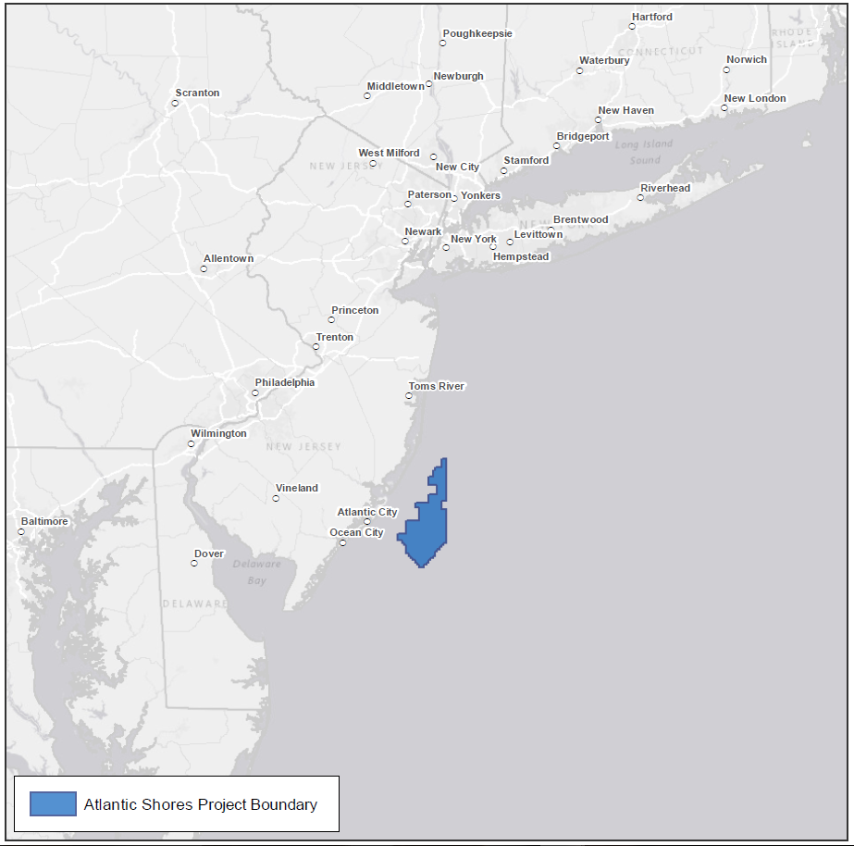
Atlantic Shores BOEM Wind Energy Lease Area
BOEM Lease Area OCS-A 0499
Up to 2.5 GW of offshore wind projects
183,000 acres
Approximately 8-20 miles off the coast of New Jersey
60-100’ water depth
Strategically located to deliver to the State of New Jersey (PJM) and the State of New York (NYISO)
Expected to deliver MW in the mid-2020’s
Lease Area Designed to Support a Portfolio of Projects

Slide 4

Atlantic Shores Activities To Date
Overview
DECEMBER 4, 2018 | Lease Acquisition
DECEMBER 10, 2018 | PJM Interconnection Filings
DECEMBER 28, 2019 | Filed NJ OREC Application
JANUARY 2019 | NYISO Interconnection Filing
FEBRUARY 14, 2019 | Filed NY OREC Application
FEBRUARY 2019 to PRESENT | Primary activities since filing of OREC applications: Stakeholder Engagement Resource Assessment and Marine Site Characterization Activities Advancement of Interconnection Strategy Environmental Desktop/Permitting Assessments

Slide 5
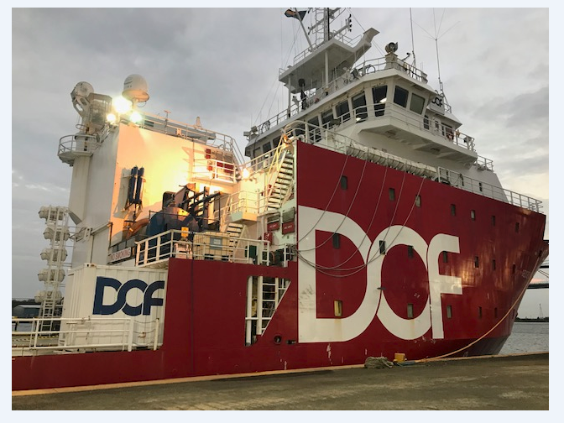
Atlantic Shores Activities
Site Assessment & Characterization
JUNE 2019 | Submitted permit applications to NOAA to support 2019-2020 Marine Geophysical/ Geotechnical Surveys
 | Rutgers University Current focus is metocean studies Visibility Study
JULY 2019 | Submitted BOEM survey plans FLiDAR site clearance Lease area Reconnaissance Surveys
 | Procured FLiDAR units
SEPT 2019 | Initiated Lease Area marine geophysical reconnaissance surveys
Q1 2020 | Metocean measurement campaign begins

Slide 6








Atlantic Shores Development Plan – Key Milestones
Q3/Q4 2019
Q2 – Q4 2020
2019 Marine Surveys (Lease Area Reconnaissance/FLIDAR Clearance)
Q4 2019
SAP Submission
Execution of Environmental Surveys and Assessments
Q1 2021
COP Submission
Q1 2020
Q4 2020
2023
Q3 – Q4 2019
Interconnection Agreement Finalized
Start of Construction
Stakeholder Mapping and Engagement Plan Initiated
SAP Approval

Slide 7
Where to Find Us
ME
Boston, MA:
Atlantic Shores Offshore Wind, LLC
1 Beacon St
Boston, MA 02108
Brooklyn, NY:
Atlantic Shores Offshore Wind, LLC
81 Prospect St
Brooklyn, NY 11201
Atlantic City, NJ:
Atlantic Shores Offshore Wind, LLC
[coming soon]
VT
NH
NY
MA
CT
RI
PA
NJ

Slide 8

Thank You.
Jessica Dealy
Project Developer
Jessica.Dealy@atlanticshoreswind.com
+ 1 646-898-3695
connect
Questions?
www.atlanticshoreswind.com
info@AtlanticShoresWind.com

